Slide 1
THE WHO, WHAT, WHEN, WHERE, WHY, AND HOW TO DETERMINE SAMPLING SITES IN A WATERSHED; AND EVALUATING THE APPROPRIATE PROTOCOL FOR DATA, RECORDS, AND COLLECTION

Slide 2
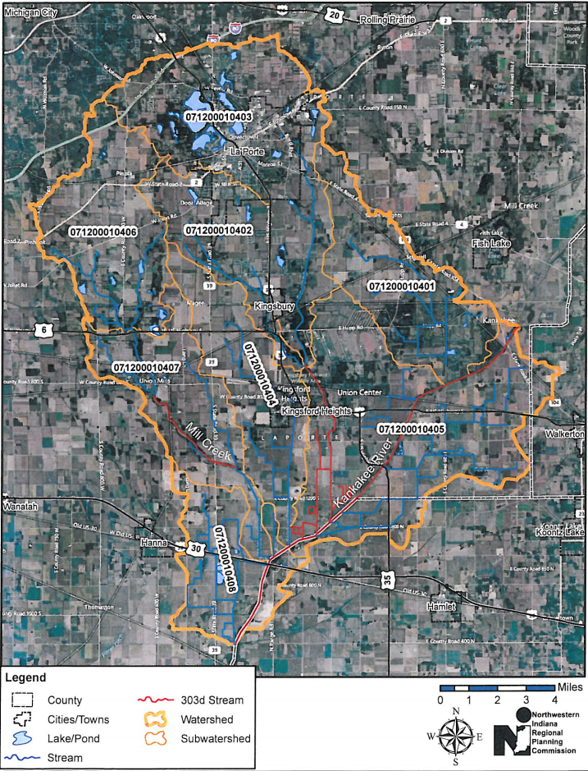
Mill Creek- KanKaKEE RIVER wATERSHED

Slide 3
REASON FOR THE PROJECT:
Our Steering Committee chose a location in LaPorte County -- the Kankakee / Mill Creek Watershed (HUC #0712000104). This watershed is huge and contains 130,000 acres, including most of LaPorte County and all of the city of LaPorte, LaPorte County's second largest city.

Slide 4
Historical Water Sampling
IDEM (Leanne Whitesell) helped us identify existing historic sampling sites.
Steering Committee identified the need to review the river and streams for impairments.
Findings
There are 2 streams and 1 river with known impairments.
E. coli habitat for aquatic life found in 2 streams.
River impairments: PCBs and mercury in fish.

Slide 5
Sampling Sites
IDEM had 27 sampling sites with varying amounts of historical data.
LaPorte City Wastewater Treatment Plant has an existing sampling site at the outfall of the city treatment plant. As a stakeholder and part
ner they are willing to share the data.

Slide 6
City of laporte wastewater treatment plant

Slide 7
SAMPLING SITES
IDEM SITES – Steering Committee determined we will only use 1 site from each sub watershed for future data collection.
STEERING COMMITTEE – Determined additional site required from outfall of Pine/Stone Lake in the city of LaPorte. This is the largest recreational lake in the watershed.
LaPorte County Health Dept. (a stakeholder and partner) does sampling at the beaches on the recreational lakes in the watershed and will share the data.

Slide 8
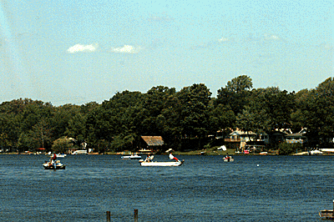
Pine lake, laporte, in

Slide 9
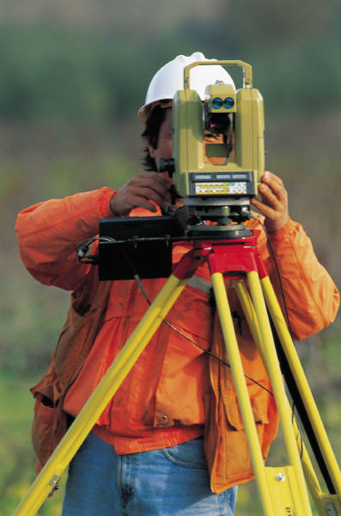
SITE LOCATIONS
The Steering Committee decided all sites will be located by GPS. Another stakeholder and partner, the LaPorte County Surveyor, offered to provide this service.

Slide 10
PROTOCOL DATA AND COLLECTIONS
Sample to be collected by LaPorte County Soil & Water Conservation District and the LaPorte County Health Department – two of our stakeholders.
Sample testing to be done by LaPorte County Health Department.
Samples to be tested for E. coli, dissolved oxygen, suspended solids, nitrates, and total phosphorous.

Slide 11
PARAMETERS AND LIMITATIONS
Impairment in the Kankakee River (PCBs and mercury in fish) can not be addressed.
Bank erosion can and is being addressed in both the river and the streams with help from another stakeholder and our match sponser, the Kankakee River Basin Commission (KRBC).

Slide 12
OUR GOAL IS TO PROTECT WATER QUALITY IN THE RIVER AND STREAMS IN THE WATERSHED. THIS IS CONSISTENT WITH THE CLEAN WATER ACT. WE WANT TO MAKE ALL WATERS IN OUR WATERSHED FISHABLE AND SWIMMABLE FOR FUTURE GENERATIONS USE.
THANKS FOR YOUR ATTENTION.

